Slide 1
Regression
Lecture 6

Slide 2
What is Regression
Regression analysis is a statistical method that helps us to analyze and understand the relationship between two or more variables of interest.
It helps to understand which factors are important, which factors can be ignored, and how they are influencing each other. In other words analyze the specific relationships between the independent variables and the dependent variable.
In regression, we normally have one dependent variable and one or more independent variables. Forecast the value of a dependent variable (Y) from the value of independent variables (X1, X2,…Xk.).
We try to “regress” the value of dependent variable “Y” with the help of the independent variables.

Slide 3
Types of Regression approaches
There are many types of regression approaches we will study some of them here
Simple Linear Regression
Multiple Linear Regression
Polynomial Regression
Support Vector for Regression (SVR)
Decision Tree Regression
Random Forest Regression

Slide 4
Simple linear regression
In statistics, simple linear regression is a linear regression model with a single explanatory variable.
It concerns two-dimensional sample points with one independent variable and one dependent variable (conventionally, the x and y coordinates in a Cartesian coordinate system)
It finds a linear function (a non-vertical straight line) that, as accurately as possible, predicts the dependent variable values as a function of the independent variable.
Simply put, Simple linear regression is used to estimate the relationship between two quantitative variables.

Slide 6
What can simple linear regression be used for?
You can use simple linear regression when you want to know:
How strong the relationship is between two variables (e.g. the relationship between rainfall and soil erosion).
The value of the dependent variable at a certain value of the independent variable (e.g. the amount of soil erosion at a certain level of rainfall).

Slide 7
Model for simple linear regression
Consider the equation of line given as,
Where y is the dependent variable, x is the independent variable, b0 is the y-intercept and b1 is the slope of the line.
We need to find b0 and b1 to estimate y using x , such that the error Ɛ is minimized between the predicted value of y and original value of y.

Slide 8
The Model
The model has a deterministic and a probabilistic components
House
Cost
Building a house costs about
$75 per square foot.
House cost = 25000 + 75(Size)
Most lots sell
for $25,000
House size

Slide 9
However, house cost vary even among same size houses!
Since cost behave unpredictably, we add a random component.
House
Cost
Most lots sell
for $25,000
House cost = 25000 + 75 (Size)
+ ε
House size

Slide 10

The first order linear model
Y = dependent variable
X = independent variable
β₀ = Y-intercept
β = slope of the line
ε = error variable
and β are unknown population parameters, therefore are estimated
from the data.
Y
Rise
β₁ = Rise/Run
β₀
Run
X

Slide 11
Estimating the Coefficients
The estimates are determined by
drawing a sample from the population of interest,
calculating sample statistics.
producing a straight line that cuts into the data.
Y
w
Question: What should be considered a good line?
w
w
w
w
w w w w
w
w w
w w
w
X

Slide 12
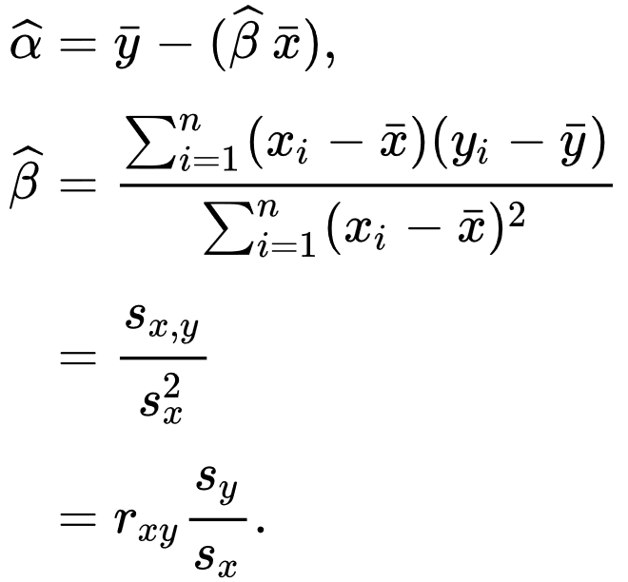
We can find the α and ꞵ that minimize the error as,
Where xi and yi are the ith instance of independent variable x and dependent variable y respectively
is the mean of x
is the mean of y

Slide 13
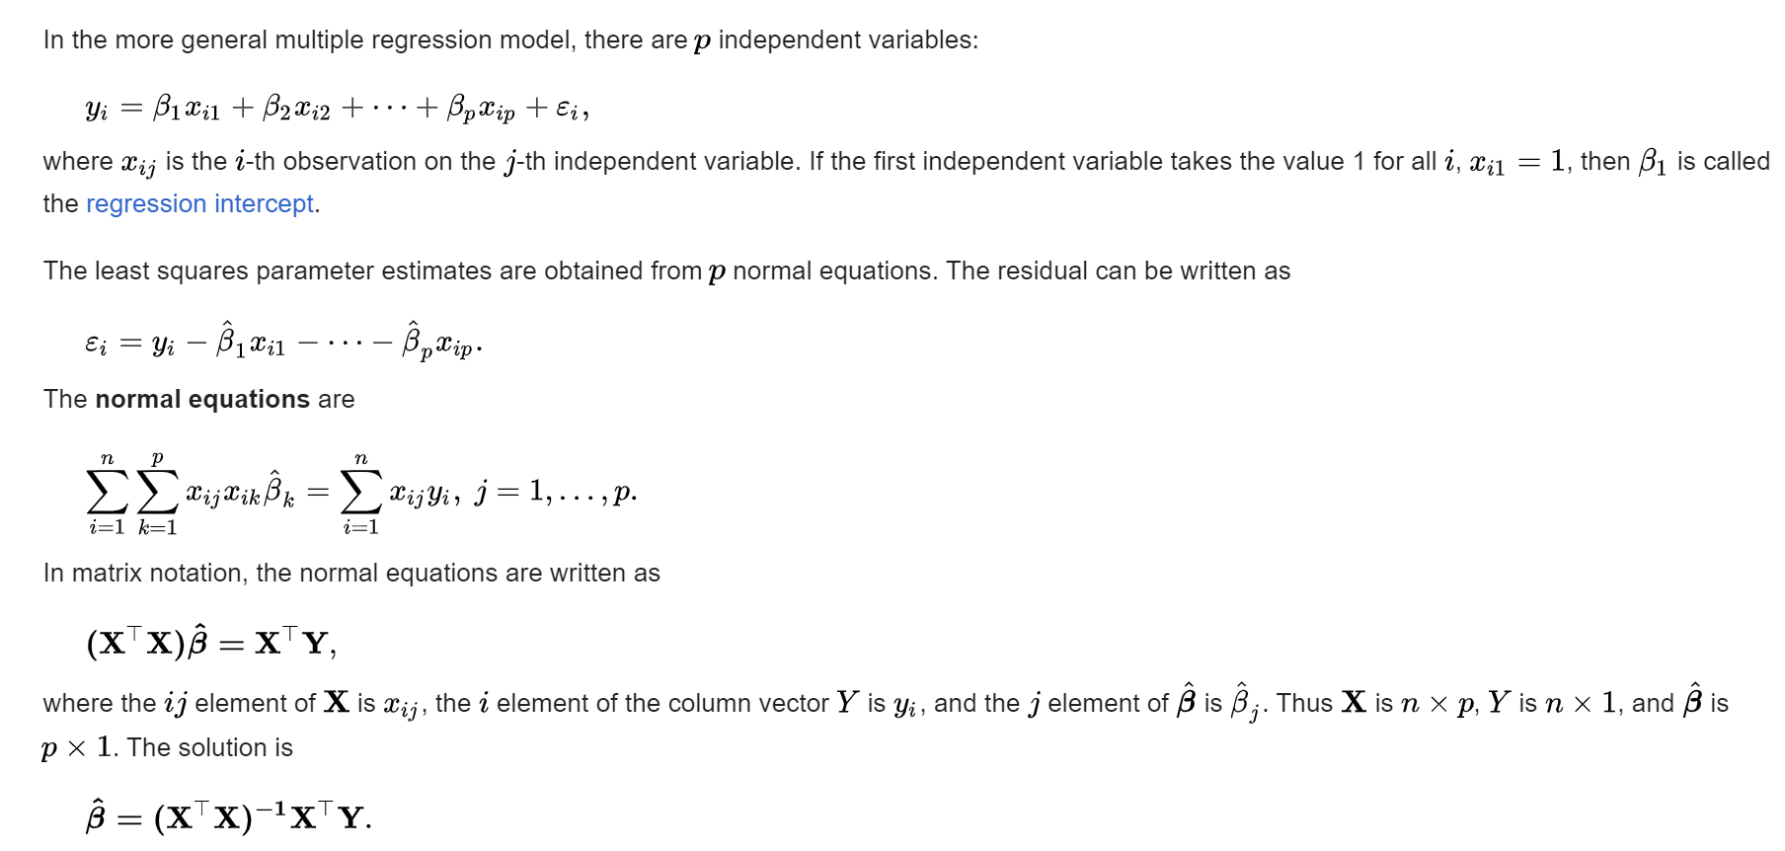
General linear model

Slide 14
Working concept of simple linear regression
Ordinary least squares (OLS) method is usually used to implement simple linear regression.
A good line is one that minimizes the sum of squared differences between the points and the line.
The accuracy of each predicted value is measured by its squared residual (vertical distance between the point of the data set and the fitted line), and the goal is to make the sum of these squared deviations as small as possible.
Y
w
w
w
w
w
w w w w
w
w w
w w
w
X

Slide 15
Sum of squared differences =
(2 - 1)² +
(4 - 2)² +
(1.5 - 3)² +
(3.2 - 4)² = 6.89
Sum of squared differences =
(2 -2.5)² +
(4 - 2.5)² +
(1.5 - 2.5)² +
(3.2 - 2.5)² = 3.99
Let us compare two lines
4
(2,4)
w
The second line is horizontal
3
w
(4,3.2)
2.5
2
w
(1,2)
(3,1.5)
w
1
The smaller the sum of
squared differences
the better the fit of the
line to the data.
1
2
3
4

Slide 16
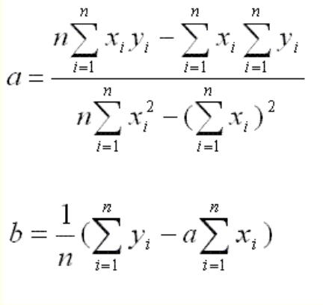
The Simple Linear Regression Line

Slide 17
Example
The values of y and their corresponding values of y are shown in the table below
x | 0 | 1 | 2 | 3 | 4
y | 2 | 3 | 5 | 4 | 6
Find the least square regression line y = a x + b.
Solution:
We use a table to calculate a and b.
x | y | x y | x ²
0 | 2 | 0 | 0
1 | 3 | 3 | 1
2 | 5 | 10 | 4
3 | 4 | 12 | 9
4 | 6 | 24 | 16
?x = 10 | ?y = 20 | ?x y = 49 | ?x² = 30
We now calculate a and b using the least square regression formulas for a and b. a = 0.9 b = 2.2 Now that we have the least square regression line
y = 0.9 x + 2.2,

Slide 18
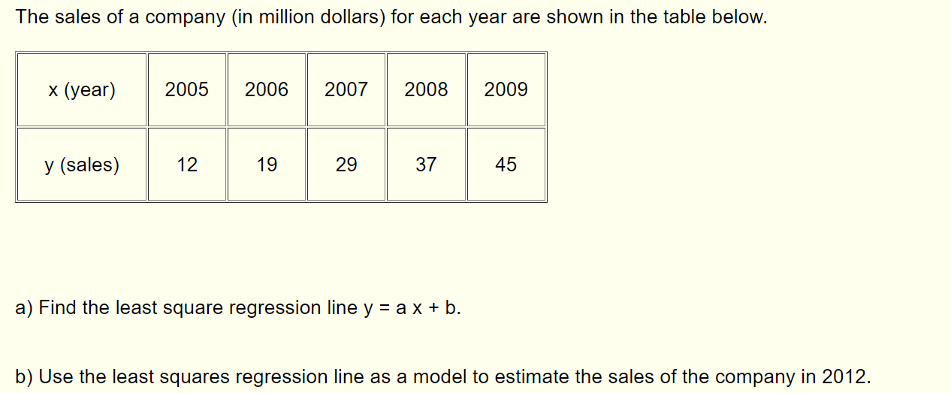
Example 2

Slide 19
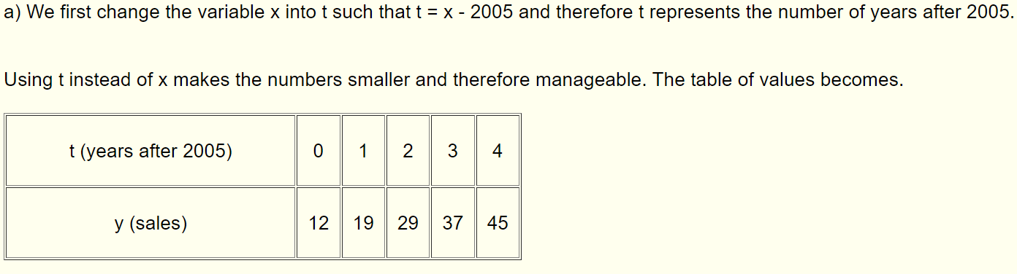
a)
a = 8.4 b = 11.6 b) In 2012, t = 2012 - 2005 = 7 The estimated sales in 2012 are: y = 8.4 * 7 + 11.6 = 70.4 million dollars.

Slide 20
Error Variable: Required Conditions for better performance of simple linear regression
The error ε is a critical part of the regression model.
Four requirements involving the distribution of ε must be satisfied.
The probability distribution of ε is normal.
The mean of ε is zero: E(ε) = 0.
The standard deviation of ε is σ_{ε} for all values of X.
The set of errors associated with different values of Y are all independent.

Slide 21
The Normality of ε
E(Y|X₃)
The standard deviation remains constant,
β₀ + β₁ X₃
μ₃
E(Y|X₂)
β₀ + β₁ X₂
μ₂
but the mean value changes with X
E(Y|X₁)
β₀ + β₁X₁
μ₁
X₁
X₂
X₃
From the first three assumptions we
have: Y is normally distributed with mean E(Y) = β₀ + β₁X, and a constant standard deviation σ_{ε}

Slide 22
Assessing the Model
The least squares method will produce a regression line whether or not there are linear relationship between X and Y.
Consequently, it is important to assess how well the linear model fits the data.
Several methods are used to assess the model. All are based on the sum of squares for errors, SSE.

Slide 23
Sum of Squares for Errors
This is the sum of differences between the points and the regression line.
It can serve as a measure of how well the line fits the data. SSE is defined by
A shortcut formula

Slide 24
Standard Error of Estimate
The mean error is equal to zero.
If σ_{ε} is small the errors tend to be close to zero (close to the mean error). Then, the model fits the data well.
Therefore, we can, use σ_{ε} as a measure of the suitability of using a linear model.
An estimator of σ_{ε} is given by s_{ε}

Slide 25
We can draw inference about β₁ from b₁ by testing
H₀: β₁ = 0
H₁: β₁ ≠ 0 (or < 0,or > 0)
b1 is the slope computed for the simple linear regression
The test statistic is
If the error variable is normally distributed, the statistic has Student t distribution with degree of freedom= n-2.
where
The standard error of b₁.

Slide 26
Assumptions of simple linear regression
Simple linear regression is a parametric test, meaning that it makes certain assumptions about the data. These assumptions are:
Homogeneity of variance (homoscedasticity): the size of the error in our prediction doesn’t change significantly across the values of the independent variable.
Independence of observations: the observations in the dataset were collected using statistically valid sampling methods, and there are no hidden relationships among observations.
Normality: The data follows a normal distribution.
The relationship between the independent and dependent variable is linear: the line of best fit through the data points is a straight line (rather than a curve or some sort of grouping factor).
If your data do not meet the assumptions of homoscedasticity or normality, you may be able to use a nonparametric test instead, such as the Spearman rank test.

Slide 27
Example: Data that doesn’t meet the assumptions
You think there is a linear relationship between meat consumption and the incidence of cancer in the U.S.
However, you find that much more data has been collected at high rates of meat consumption than at low rates of meat consumption,
With the result that there is much more variation in the estimate of cancer rates at the low range than at the high range.
Because the data violate the assumption of homoscedasticity, it doesn’t work for regression.

Slide 28
Implementing simple linear regression in Python
Import the packages and classes .
Import the data
Visualize the data
Handle missing values and clean the data
Split the data into training and test sets
Build the regression model and train it.
Check the results of model fitting to know whether the model is satisfactory using plots.
Make predictions using unseen data.

Slide 29
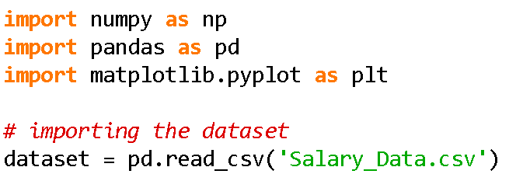
Importing packages and data

Slide 30
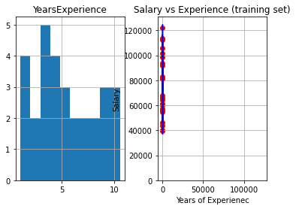
Visualize the data

Slide 31
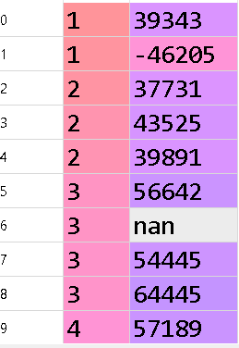
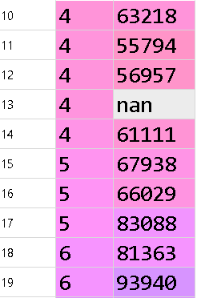
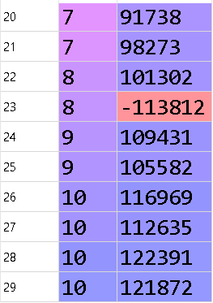
Handle missing values and clean the data
Missing data present
Data cleaning is required as salary cannot be negative

Slide 32
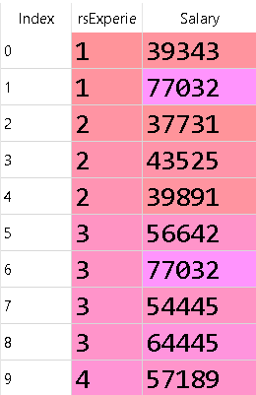
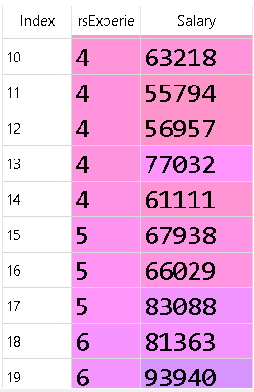
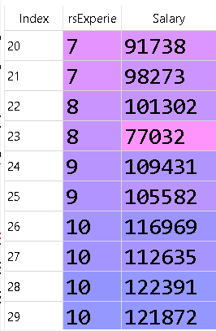
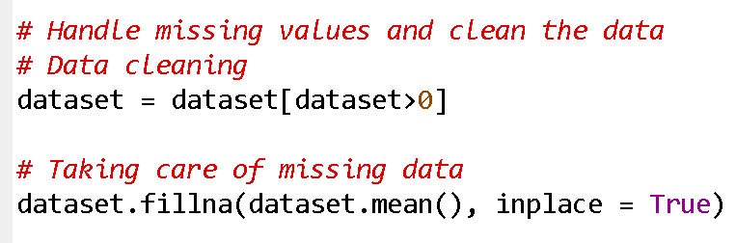
code

Slide 33
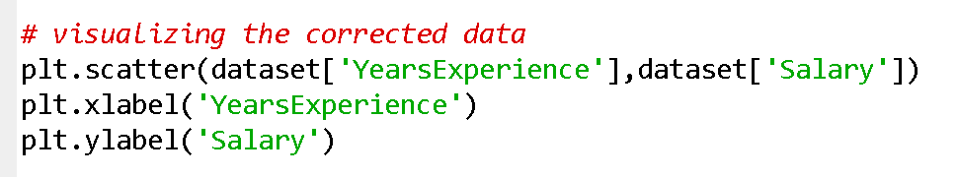
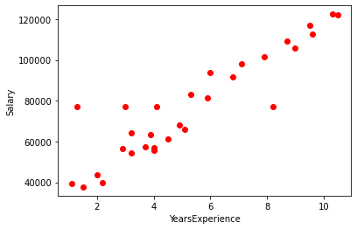
Visualizing the processed data

Slide 34
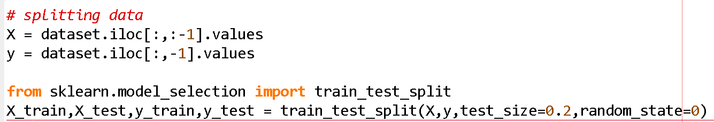
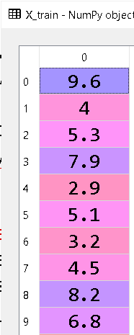
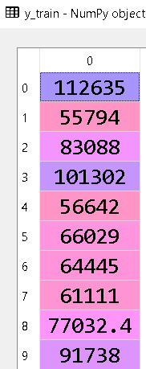
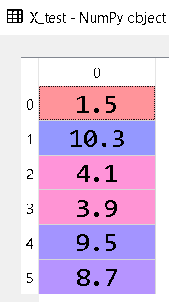
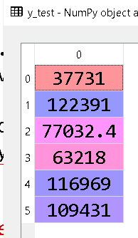
Split the data into training and test sets

Slide 35
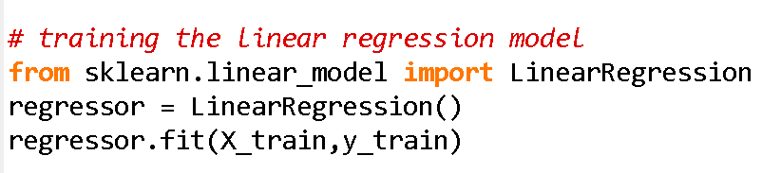

Build the regression model and train it.
Import the linear regression class from the linear model
Make an instance of the linear regression class
The train the model using training data

Slide 36
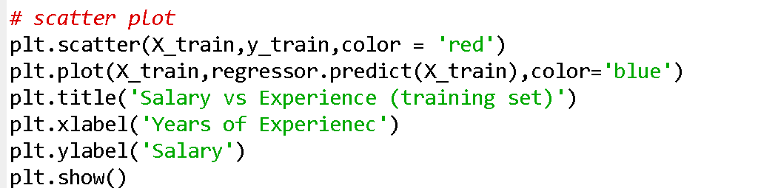
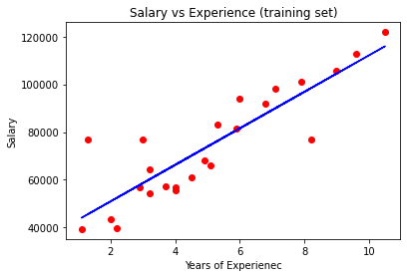
Check the results of model fitting to know whether the model is satisfactory using plots.

Slide 37

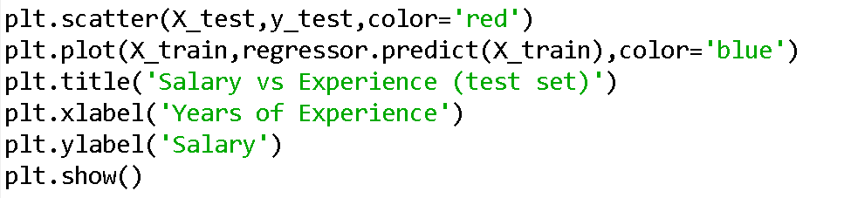
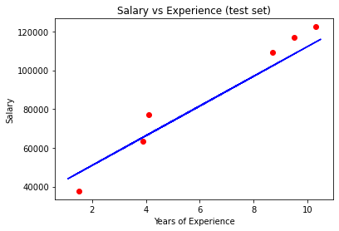
Make predictions using unseen data.

Slide 38
Another Example

Slide 39
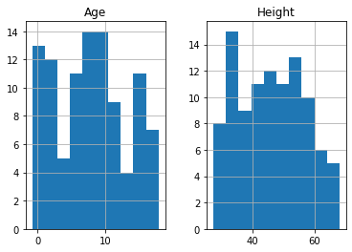
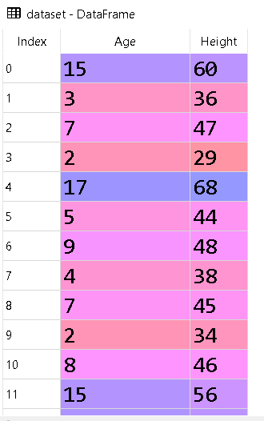
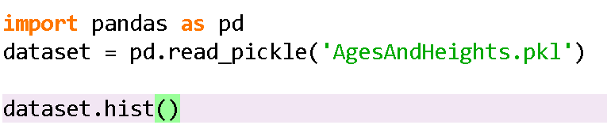
Import dataset and visualize

Slide 40
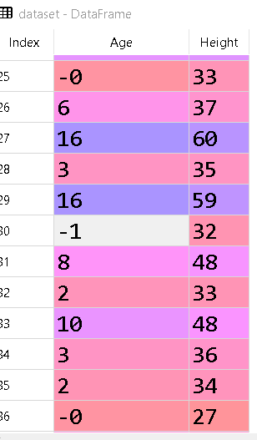


Data cleaning

Slide 41
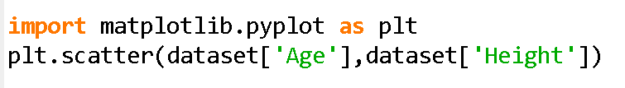
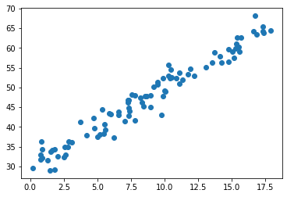
Visualize the data

Slide 42
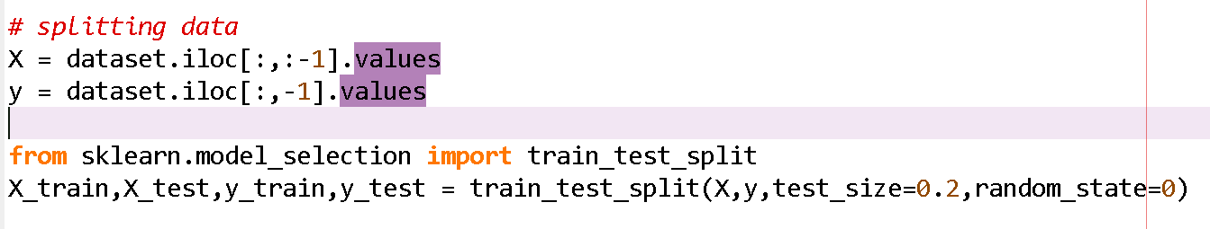
Splitting the data

Slide 43
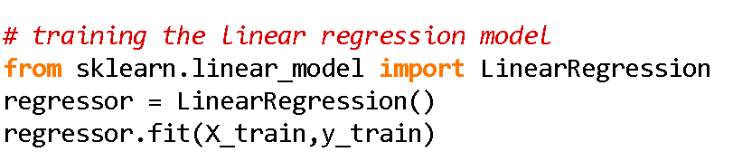
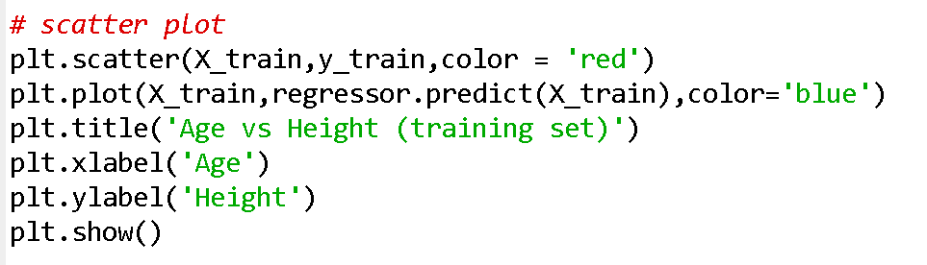
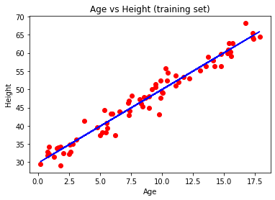
Build model and train it

Slide 44
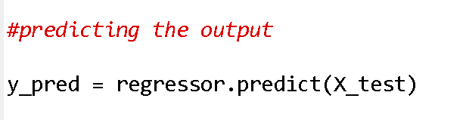
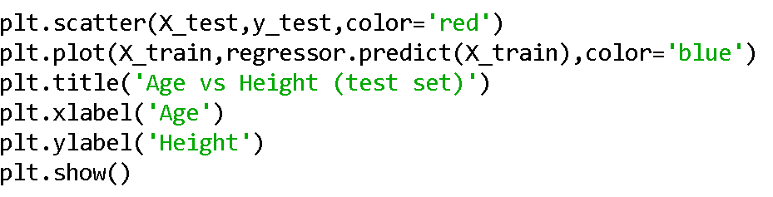
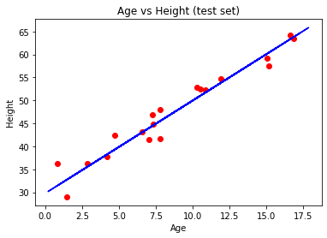
Predicting the output for unseen data

